Slide 1
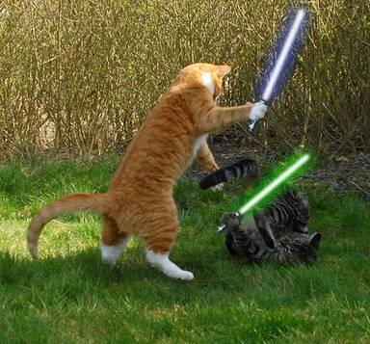
Dealing with
a combative user
Notes:
When dealing with a combative user, the first thing we have to do is....

Slide 2


Understand the angry user’s mindset.
???
Notes:
Instead of getting defensive when they yell at us, or just ignoring their anger altogether, we have to figure out why they believe they’re justified to be angry at us.
And to do that, we start by making an important distinction:

Slide 3


Two levels of angry users
1. User is frustrated, but still looking for a solution. They just want their problem fixed.
2. User is beyond wanting a solution. Now they want someone to blame.
Notes:
With the Level 1 angry user, if we give them a solution, their anger will disappear.
With the Level 2 angry user, just finding them a solution may not be enough, because....

Slide 4
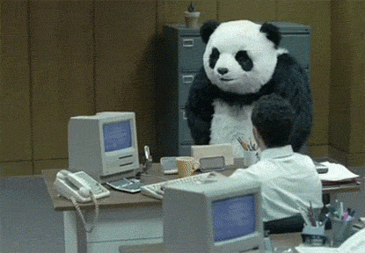
This user sees us as the enemy. We are the source of their problems.
Notes:
Their mindset has shifted from, “I want to solve my problem,” to “I want to break somebody!” And this is when they get combative.
Basically....

Slide 5

The user thinks we’re unable or unwilling to help.
We’re trying to help the user.
They don’t trust us.
Notes:
For whatever reason – maybe they’ve had poor interactions with us in the past, maybe we did screw up, or maybe they just short-tempered and kind of entitled – the user doesn’t trust us. And when they get to this mindset, they will resist our attempts to find a solution for them.
So, before we can even begin helping them, we have to get them to this mindset:

Slide 6

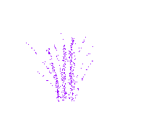

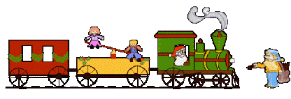

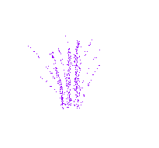
The user understands we’re here to help.
We’re trying to help the user.
Notes:
In fact, if we don’t change their mindset first, if we ignore their anger and just focus on finding a solution, we can actually make them even angrier. Here’s why....

Slide 7



You, hypothetically...
Notes:
Let’s say you’re mad at someone, for something you believe they did to you on purpose. It may not be true, but it’s what you believe. Going with this premise, what’s the worst thing this person you’re angry at can do to you? Get defensive? Fight back? Not necessarily.
Now obviously, devolving into an actual argument is totally unproductive. But ironically, if the other person fights back, then they’re acknowledging your anger. And on some level, that feels satisfying. Because when you’re upset at someone, what you want, first and foremost, is to have your feelings be validated. And the worst thing the other person can do to you? Is ignore your feelings and talk to you like nothing is wrong. It just feels dismissive.
So this is what we need to keep in mind....

Slide 8

An angry user doesn’t need a solution (at that moment). They need empathy.
Notes:
They need someone to acknowledge how angry they are. And that’s why, when a user gets combative, we have to validate their feelings and change their mindset before we can get anything done.
Plus, there’s an ulterior reason we need to create empathy....

Slide 9
Offering an alternative solution
If the user believes we’re trying to screw them over, an alternative solution is proof that we won’t give them what they want.
If the user believes we’re trying to help, an alternative solution means we care enough to offer them something else.
Notes:
The reality is, we can’t always give the user the perfect solution they want. Sometimes, what they want just isn’t possible. Other times, they’ll ask these rhetorical questions that we really can’t answer (“Why is your software so hard to use?”... “Why are so few people visiting to my blog?”). Point being, we often cannot give the user the answer they want. We can only offer an alternative. And this is where empathy becomes vital.
It’s a two-way street. If we offer them empathy and show them that we understand their feelings, that will make them much more likely to empathize with us and understand when we can’t give them the perfect solution.

Slide 10

Empathy makes the user more willing to compromise with us.
Notes:
And often, we need them to compromise with us. Okay, so that takes us to the million-dollar question....

Slide 11
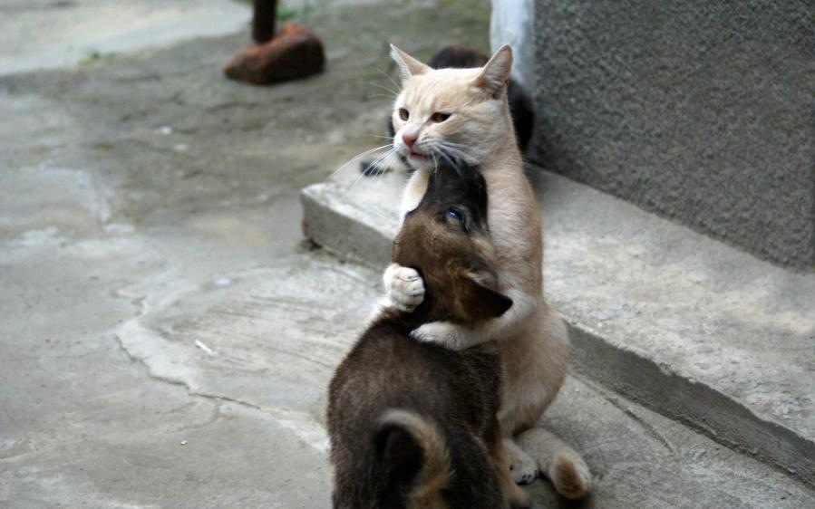
How do we create empathy?
Notes:
Personally, I think the most important part is just to understand the user’s perspective. Empathy is a state of mind, not a checklist of steps. It’s kinda zen-like.
Having said that, if we were to break it down into steps, this now takes us to our next section....

Slide 12
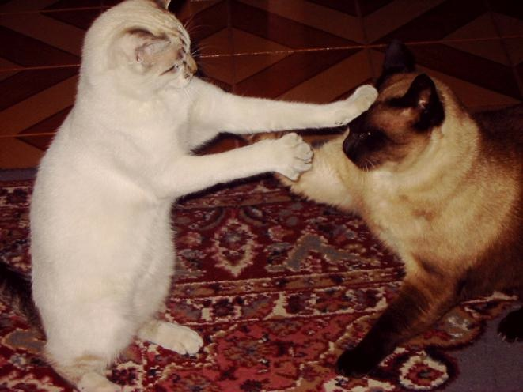
Strategies to defuse user anger
Notes:
Before we get into these general strategies, though, there are two important rules that we have to go over. Rule #1:

Slide 13
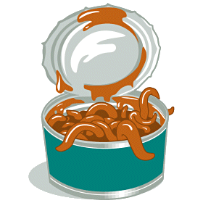
Avoid canned lines.
Notes:
There are a ton of customer service books out there. And they’re generally decent. However, many of them take complex human interactions and distill them into simple, catch-all solutions. So when these books give us example lines that we can say to make customers happy....

Slide 14
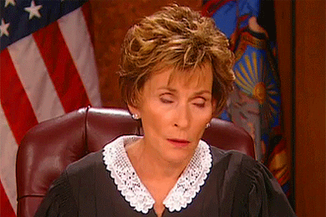
How can I help you have a great experience today?
I’m sorry you feel this way.
Let’s see what we can do to make things right.
I understand where you’re coming from, and I will do my best to help you.
Notes:
We have to take them with a very large handful of salt. The problem is that many of these lines have become ingrained in basic customer service. These are lines we’ve all heard support people say. And that means that, chances are, an angry user has heard all these lines before, too. They’re kinda like the customer service equivalent of cheesy pickup lines. And if we use them, the user is immediately going to be turned off. They’re going to think we’re just reading off a script to appease them.
So that’s Rule #1: No canned lines. Rule #2:

Slide 15

Assert ourselves in a respectful way that doesn’t attack the user.
Notes:
In just a minute, I’m going to show an excerpt from an actual chat I had with a user. Some of you may feel a bit squeamish with some of the harsher comments I’ll be suggesting. But keep in mind that building rapport and connecting with another person also entails being assertive when necessary. We don’t connect with someone by being a pushover. All that be does is empower them to become even more aggressive and take advantage of us. We have to stick up for ourselves. We just have to do it in a respectful way.
Having said that, let’s talk about some specific strategies now. When dealing with an angry user, the first thing we have to do is figure out if they’re at….

Slide 16
Level 1 or Level 2?
Start off by focusing on solutions.
If they become verbally abusive, explain that their comments are inappropriate. Then let it go, and continue working on solutions.
If the verbal abuse continues, or if they resist our help, make it clear that their behavior is hindering our ability to find a solution for them.
Notes:
So, let’s look at that example chat now. I’ll walk you through my thought process, and then you can see how I applied these techniques:

Slide 17
Lol
Whoever just answered my question didn't help at all, whatsoever
Hi there!
They couldn't figure it out so they ended chat
Tell _____ that he's a fucking moron
We are happy to help you, but we will not tolerate abusive language.
If you want our continued help, I'm going to ask you to be respectful.
Sorry
Just tell him he's horrible
Notes:
This user is combative from the start. I decide I need to say something right away, because of the personal attack. But, I keep it relatively curt for now.
His apology is nice. But, he still won’t let go of his personal grudge against the last support person. So, I reiterate....

Slide 18
Again, I am going to ask you to be respectful.
We are here to help you, not be abused.
OK sorry
Anyway
Before you call me a moron, too, has it occurred to you that you're not being as clear as you might think?
We can keep going back and forth, or you can just answer my questions. Only one of these options will allow me to help you.
Im being such a troll, i'm sorry lol
OK so i'll stop being rude
Notes:
After his second apology, it looks like we’re in the clear, and we start discussing the issue itself. But then, a few minutes later, he starts getting combative again and refuses to answer the questions I’m asking. He insists that he’s already explained everything. So I have to assert myself again, this time a bit blunter.
A few more exchanges, me asking him questions, and him continuing to resist, and I assert myself a third time. And that’s when he finally backs down.
This is an example of a user who wasn’t quite at Level 2. I drew the line pretty early on, because he came out swinging. But as soon as I drew the line, I let it go and moved back to solutions-finding. Unfortunately, it wasn’t enough, so I had to re-draw the line a few more times, until he finally backed down, and then we could start working on a solution for him.
And that takes us now to the tricky part....

Slide 19
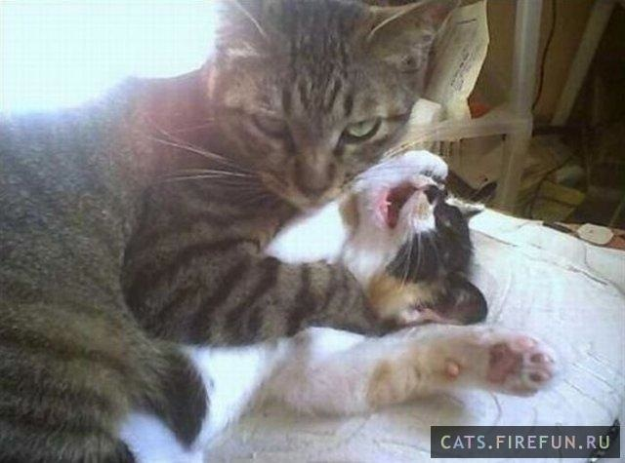
What if the user is at Level 2?
Notes:
We’ve been firm multiple times, but they’re still angry and still attacking us. So now, I’m going to go over four strategies to deal with Level 2 anger.

Slide 20
Dealing with Level 2 anger
Point out inappropriate behaviors, but avoid making judgments against the person.
Notes:
These strategies are a combination of assertion and empathy, and they’re not in any set order. As long as our ultimate goal is to connect with the user, then we just have to use our best judgment on when any specific strategy is appropriate.
Let’s start with being assertive. What if we said....

Slide 21


If you continue to be difficult, then I can’t help you.
If you continue to curse at me, then I can’t help you.
Are we calling out something they do? Or something they are?
Notes:
[Example 1] is not good, because we’re not addressing anything they’re doing. We’re just insulting their character. Instead, we say [Example 2]. Now, we’re pointing out a specific behavior that we’d like them to change, and not just accusing them of being “difficult.”
Sometimes, this concept can be tricky. So when in doubt, here’s a simple litmus test: Something they do can be changed. Something they are cannot, so it’s not productive.
By the way, this one is super-important if you’re ever in a fight with a significant other. Think about the accusation, “Why are you being so crazy?!?”
And building on this....

Slide 22
Dealing with Level 2 anger
Point out inappropriate behaviors, but avoid making judgments against the person.
When making a request, address a specific action. Don’t be vague!
Notes:
What if we said something like this?

Slide 23
Please calm down.
When I asked you to check your site on another browser, please do so. That’s how I can investigate your issue.
If you want me to help you, I need you to listen to me.
Notes:
I hope we all realize that [Example 1[ is a horrible, horrible thing to say to someone who’s upset. Even [Example 2] s still pretty bad. The problem with these is that they’re accusatory and easily deniable. The user can just retort with, “I am calm,” or “I am listening.” Even if we know they’re not, we can’t prove it, so it’s unproductive.
Instead, we say something like [Example 3]. Now, we’re pointing out a specific thing that we need from them.
Of course, sometimes these requests, even phrased this way, are still met with resistance. So that’s when we might switch gears and start focusing on empathy....

Slide 24
Dealing with Level 2 anger
Point out inappropriate behaviors, but avoid making judgments against the person.
When making a request, address a specific action. Don’t be vague!
Reflect back the user’s frustrated comments.
Notes:
And phrasing is important here.

Slide 25
I understand
I can tell you’re feeling frustrated that your home page isn’t displaying properly.
I understand you’re frustrated
Don’t overdo this one, because it can start to sound like we’re mocking them!
Notes:
[Examples 1 and 2] just sound like empty reassurances. [Example 3]: Now we’re making it clear that we do get why they’re their frustrated.
Again, the point is to acknowledge their feelings. Don’t ignore them. And be sincere. Or at least sound like you are.

Slide 26
Dealing with Level 2 anger
Point out inappropriate behaviors, but avoid making judgments against the person.
When making a request, address a specific action. Don’t be vague!
Reflect back the user’s frustrated comments.
Keep empathy and solutions separate.
Notes:
Let’s say the user says this....

Slide 27
I’m so frustrated with your software.
I understand your frustration. We do offer quite a bit of customization, so if you tell me what you’re having issues with, I’m happy to help.
I’m really sorry to hear that. Is there anything I can do to help you feel less frustrated?
Empathy only when offering empathy. Explanations when the user is ready for solutions.
Notes:
And we reply with [Example 1]. Now, there’s actually nothing wrong with this statement. And chances are, we’re going to say something like this at some point. We just have to remember that if someone is at Level 2, we need to validate their anger first: [Example 2].
And if we continue to focus on empathy for now, at some point, we’ll hopefully start to see a shift in their tone. The accusations will fade away, and they’ll become friendlier and more receptive to us.

Slide 28
Dealing with Level 2 anger
Point out inappropriate behaviors, but avoid making judgments against the person.
When making a request, address a specific action. Don’t be vague!
Reflect back the user’s frustrated comments.
Keep empathy and solutions separate.
Notes:
So these are the general steps that we can take when we’re dealing with an angry user. It’s a gradual, wearing-down process. We try to find a solution. If they resist, we assert ourselves. If they keep resisting, maybe they need empathy. And then we go back to solutions. And then later on, maybe they need more empathy, or we need to assert ourselves one more time, so we shift again. And so on and so forth.
And that’s how we accomplish our goal to....

Slide 29
Empathize with our users...
Give them a chance to care about us...
Reach a happy compromise for all involved.
Notes:
And hopefully, you can see how these concepts will help with your everyday interactions, too. They’re not just for user support. They’re just good communication skills.

Slide 30
Bibliography
Social Intelligence: The New Science of Human Relationships, Daniel Goleman
Nonviolent Communication, Marshall B. Rosenberg
Crucial Conversations: Tools for Talking when Stakes are High, Kerry Patterson et al.
Influence: The Psychology of Persuasion, Robert Cialdini
DennisHHong.com/UserConf
Notes:
And finally, if you liked this talk, here’s some further reading that you can do. Notice that these aren’t customer service books. They’re books on communication, psychology, and social dynamics. And they’re excellent if applied to customer service.
So you don’t have to memorize them, I’ve posted these on my blog. That means you just have to memorize the name of my blog.

